Slide 1

THE ETHICS OF HEALTH DATA GOVERNANCE:
PUBLIC INTEREST VS. PRIVATE GAIN
Presented By: Pooja Pandit

Slide 2

AGENDA
Introduction
Background on UK Biobank
Public Interest
Different case studies
Hidden Risks Of Actuarial Algorithms
Key takeaways
Final Thoughts

Slide 3
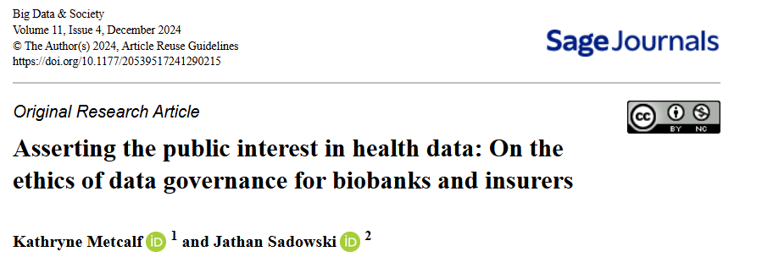

INTRODUCTION
Primary Focus : The UK Biobank controversy, reported in November 2023

Slide 4

BACKGROUND ON UK BIOBANK (UKB)
What is UK biobank?
Controversy
Two Perspectives
Critics
UKB
Breach of Public Trust
Public Interest

Slide 5
UK BIOBANK’S RESPONSE & JUSTIFICATION
UK Biobank’s Response:
Described the allegations as a “highly misleading… false narrative.”
Argued that the reporting mischaracterized UKB’s practices rather than exposing actual misconduct.
UK Biobank’s Justification for sharing data
De-Identification
Participant Consent
Public Interest

Slide 6



CRITICS' CONCERNS
Identifying new health risks = New financial risks for insurers
Potential Harm (Problem of Inverse selection):
Minimize payouts
Higher premiums or policy denials for individuals flagged as “high risk.”
Increased health disparities
Only the healthiest will be insurable
Other concerns:
From Biobanking to (Bio)Capital: The Commercialization of Health Data
Can public health data be used ethically while still being financially valuable?

Slide 7

WHAT IS “PUBLIC INTEREST”?
Walter Lippmann’s Definition:
“The public interest may be presumed to be what men would choose if they saw clearly, thought rationally, and acted disinterestedly and benevolently.”
SIMPLE TERMS:
It is a guiding principle for governance

Slide 8

CONFUSION IN LEGAL FRAMEWORKS
GDPR (EU Regulation): Mentions public interest 70 times but never defines it (Slokenberga, 2021).
UK’s 2018 Data Protection Act (post-Brexit): Also fails to clarify the meaning.
Raises the question:
Whether a single “public” even exists?
Since the definition of "public interest" is so abstract, does this allow institutions to exploit loopholes and justify data-sharing for private gain?

Slide 9
CASE STUDIES
Case Study 1 : The 23andMe Data Scandal
Concerns:
People often consent without realizing the full implications.
2. Case Study 2 : Insurance & Wearable Data
Concerns:
Continuous surveillance – Insurance adjusts pricing in real time.
Exclusion risk – People with disabilities, chronic illnesses, or lower-income backgrounds may pay more.

Slide 10
CASE STUDIES
3. Case Study 3 : Global Issues in Genetic Discrimination
Different Countries have different Laws:
UK: Genetic discrimination in health insurance is restricted but NOT in life insurance.
US: Genetic Information Nondiscrimination Act (GINA) prevents discrimination in health insurance but allows it for life/disability insurance.
Concerns:
UKB shares data with international companies – what prevents misuse in less-regulated countries?

Slide 11



THE HIDDEN RISKS OF ACTUARIAL ALGORITHMS
Creates "black-box" risk categories that can be discriminatory.
Vertical(Direct link) vs. Horizontal Data Governance (Spread across span)
Even though de-identified data is claimed to be harmless, group-level discrimination still occurs.

Slide 12

KEY TAKEAWAYS
AI in insurance may increase inequality if left unchecked.
De-identification is NOT a perfect privacy solution.
Need stronger global laws to prevent data misuse.
Biobanks must rethink “public interest” to reflect citizen concerns.

Slide 13

FINAL THOUGHT
Health data is valuable for research, but must be governed with ethical responsibility.

Slide 14
THANK YOU!

